Slide 1
E-Portfolio SonarQube
Software Engineering
Franziska Ommer
07.06.2022

Slide 2
Agenda
Motivation
General Information
Quality Profiles
Quality Gates
Issues
Metrics
SonarLint
Live Demo

Slide 3
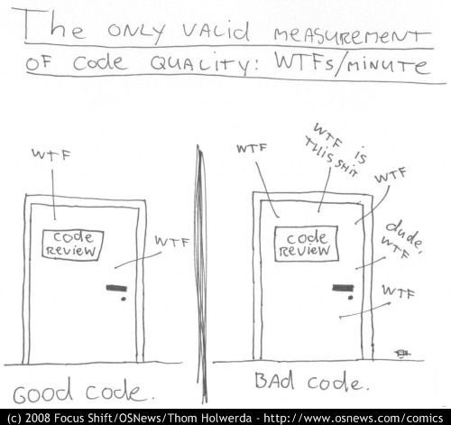
Motivation

Slide 4










General Information
Static code analysis
Supports 29 programming languages
CI/CD integration
Issues (Bugs, Vulnerabilities, Code-Smells)
Security Hotspots
Web interface
→ Cleaner and safer code

Slide 5
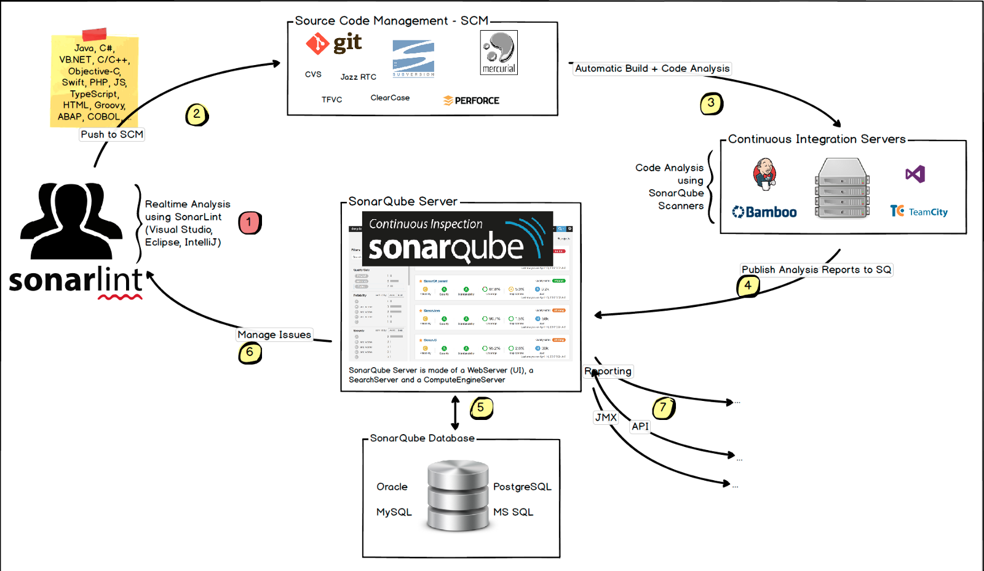

Slide 6
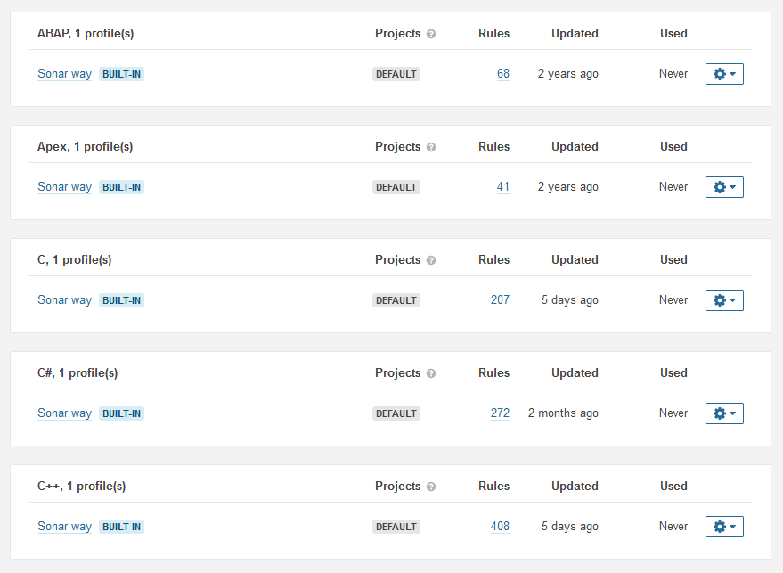
Quality Profiles
Collections of rules
Group by language
Default profiles

Slide 7
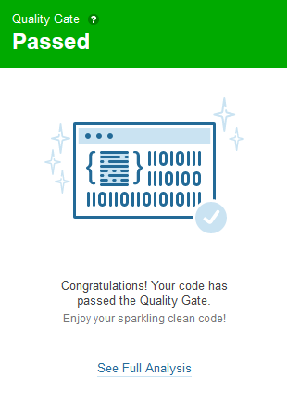
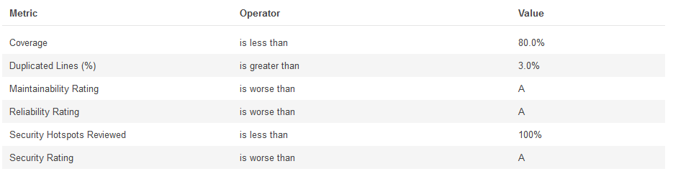
Quality Gates
Conditions for passing

Slide 8
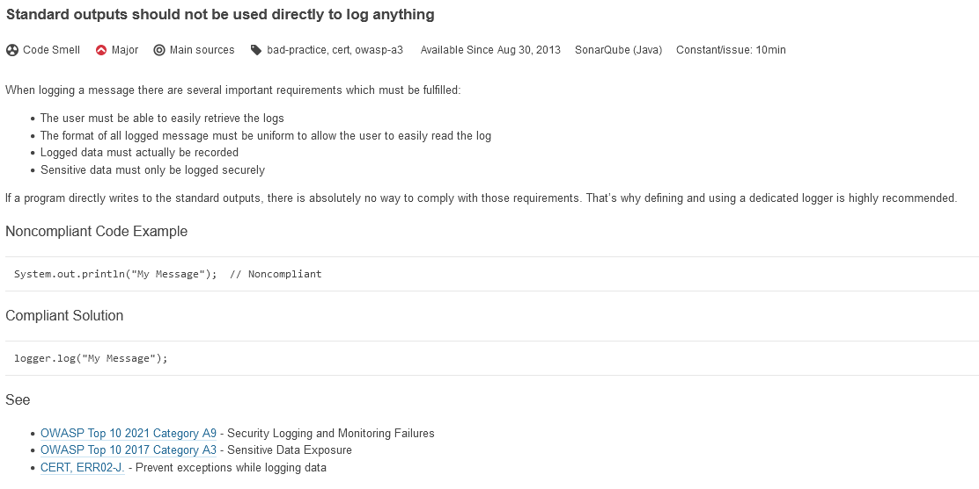
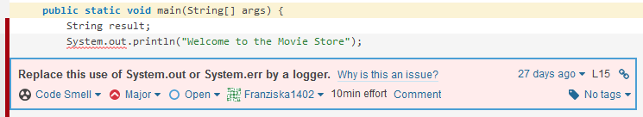
Issues
Creates issues with effort and classification
Provides compliant solution

Slide 9
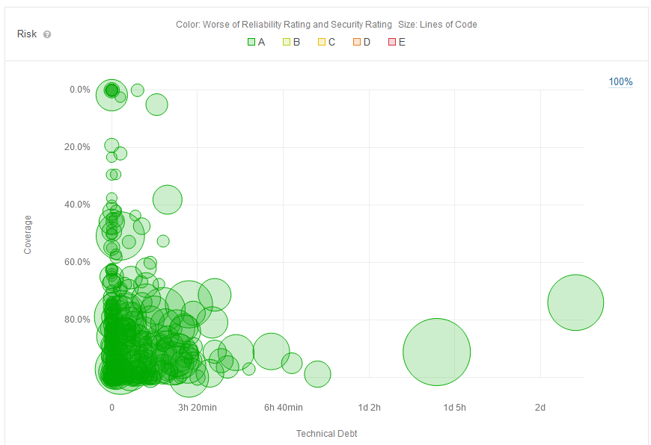
Metrics
Software properties → numerical value
Complexity
Duplications
Issues
Maintainability
Reliability
…

Slide 10

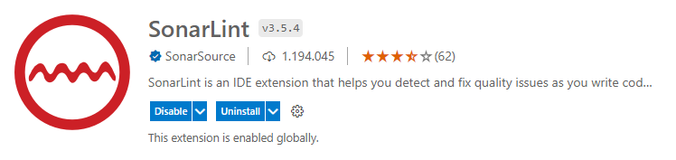
SonarLint
Plugin for IDEs
Feedback on issues directly in IDE
Server url
No security hotspots
No coverage issues

Slide 11
Live Demo
GitHub - Franziska1402/SE_E-portfolio_SonarQube

